Slide 1
Gelato in Manhattan
Coursera Data Science course capstone project

Slide 2
Business Problem
As a Gelato lover, I would like to open the ice-cream shop. Moreover, this is a high-margin business if done properly. With this work I would like to discover what neighbourhood in New York has a lesser number of such shops to open it there.
Instrumentation
In this capstone project, I will leverage the FourSquare API and K-means algorithm to find the best place to open a Gelato shop. To visualize the result of my work I will use Folium module.
Target Audience
Businessmen who are interested in high margin retail business in New York

Slide 3
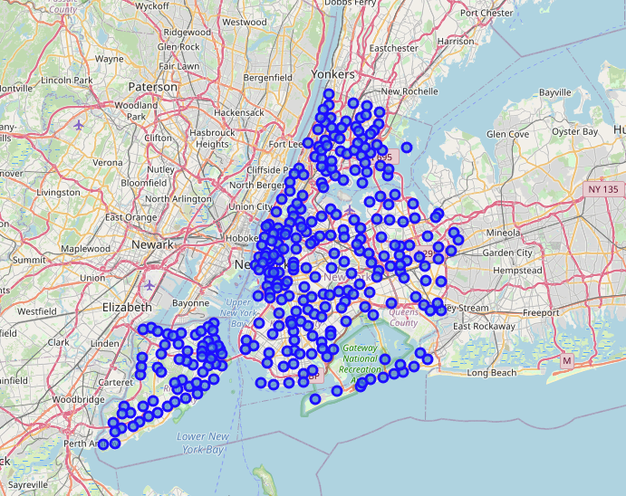
Here we load NYK neighbourhood data set and use Folium to mark them on the map

Slide 4
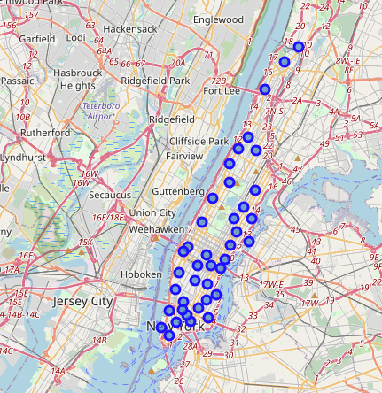
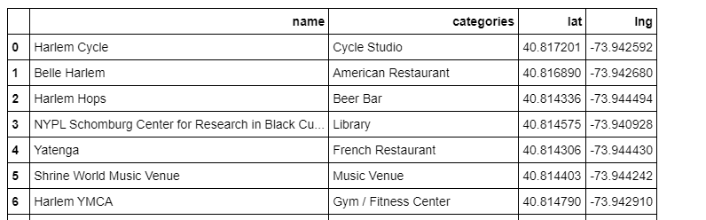
Now let’s look closer at Manhattan area, and also load all the venues we have in its heghbourhoods into a dataframe

Slide 5
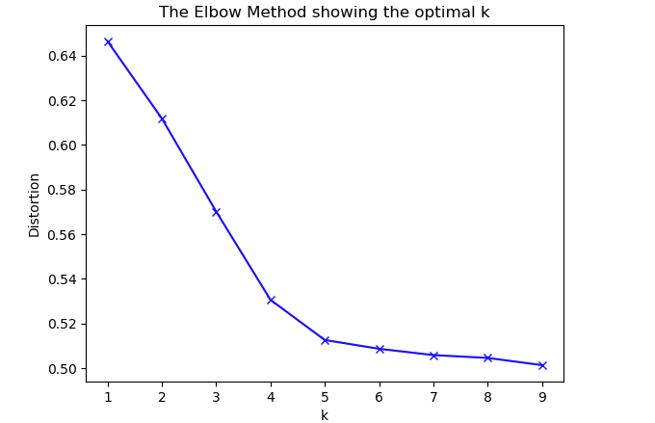
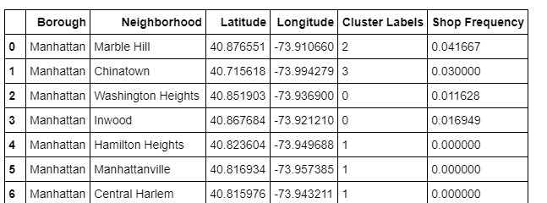
After that, as we are interested only in gelato, we filter out the rest of venues.
Next we use unsupervised machine learning algorithm K-means to cluster ice cream shops based on their number per each neighbourhood.
We also leverage elbow method to determine right number of K.

Slide 6
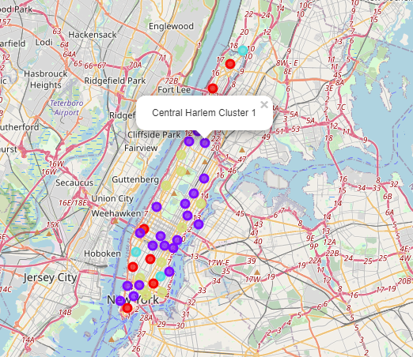
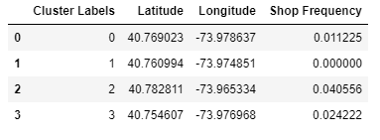
Conclusion
New York is a very crowded place in terms of venues, including ice cream shops. But still there are vacant locations.
As we can see, 2nd cluster has no ice cream shops at all, and this is the area we should look at.
You can click on any dot on the map to understand to which cluster it belongs to.
In our case we should look at purple dots on the map.

